Slide 1

Kishan Bandhu

Slide 2

1.
What is Kishan Bandhu?

Slide 3
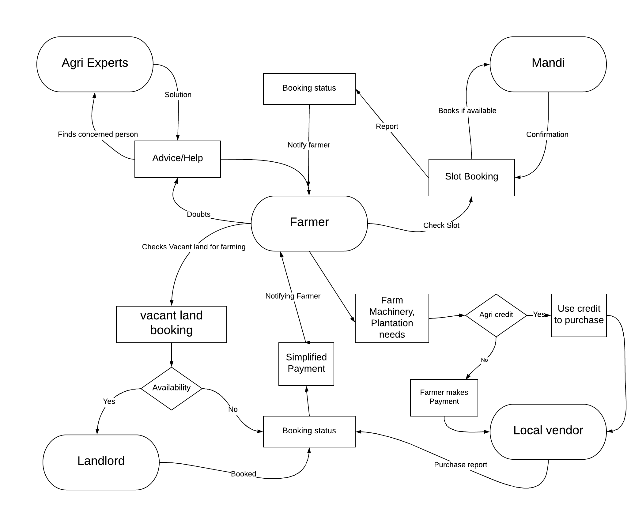

Slide 4
2.
Benefits

Slide 5
Benefits:
Farmers can have their desired land.
Farmers can lease/buy machinery.
7day Weather forecast
Easy transaction between stake holders.
Instant slot booking for mandi’s.
A roof for the farmers to know all the government scheme.
A clear work flow between the stakeholders
Farmer
Landlord
Mandi
Retailer

Slide 6
3.
Technology Stack

Slide 7
Technology stack
Frontend
HTML 5 – To design the website
CSS 3 – Style the website
Bootstrap 4 – Making website responsive
JS – Adding dynamics to website.
Jquery – HTML DOM, css animation, event handling
Backend
PHP – For all server-side scripting

Slide 8

Technology stack
Database
MySql – For relational database queries
Version Control
Git – For distributed version-control system for tracking changes in source code during website development.
Hosting
Amazon Web Service(EC2 instance) – For deploying a virtual machine along with server for hosting.

